Slide 1
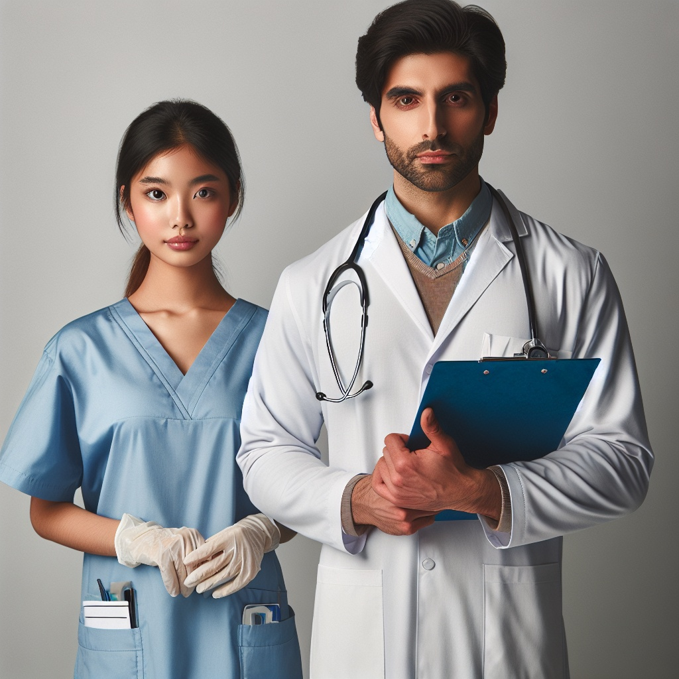
Investigation of Visual Bias In Generative AI
Jerome Agius – B.Sc. IT (Hons) Artificial Intelligence

Slide 2
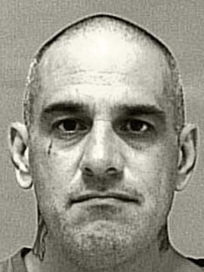
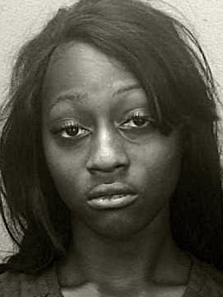
Motivation
Bias affects the applicability of applications
Affecting people's lives (Recidivism Scoring/Credit Scoring)
Bias needs to be addressed in AI systems particularly in generative endeavours and visual datasets.
Initial research goal (LAION-5B & Stable Diffusion)
Expanded research goal (LAION-400M & Stable Diffusion/Dall-E/Midjourney)
Petty Theft Arrests
Vernon Prater - LOW RISK 3
Brisha Borden - HIGH RISK 8
Figure 1: ProPublica Recidivism Scoring Example
Figure 1 - https://www.propublica.org/article/machine-bias-risk-assessments-in-criminal-sentencing

Slide 3
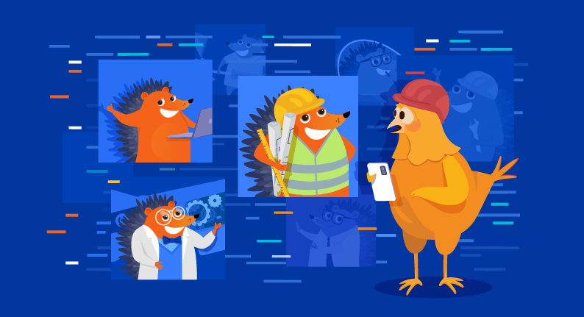
AIMS and Objectives
Identify the severity of bias within the generative models and LAION-400M dataset.
Objectives:
Determine the types of bias assess.
Determine what bias measurements to utilise.
What Images to assess?
How should the images be annotated?

Slide 4
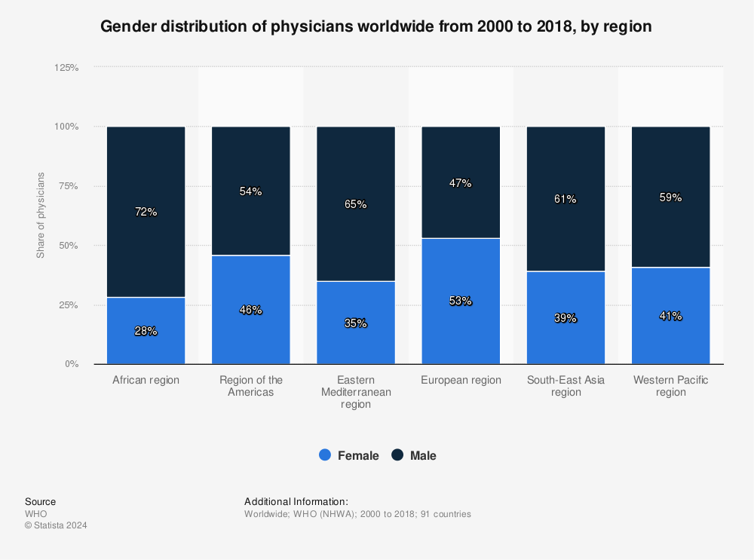
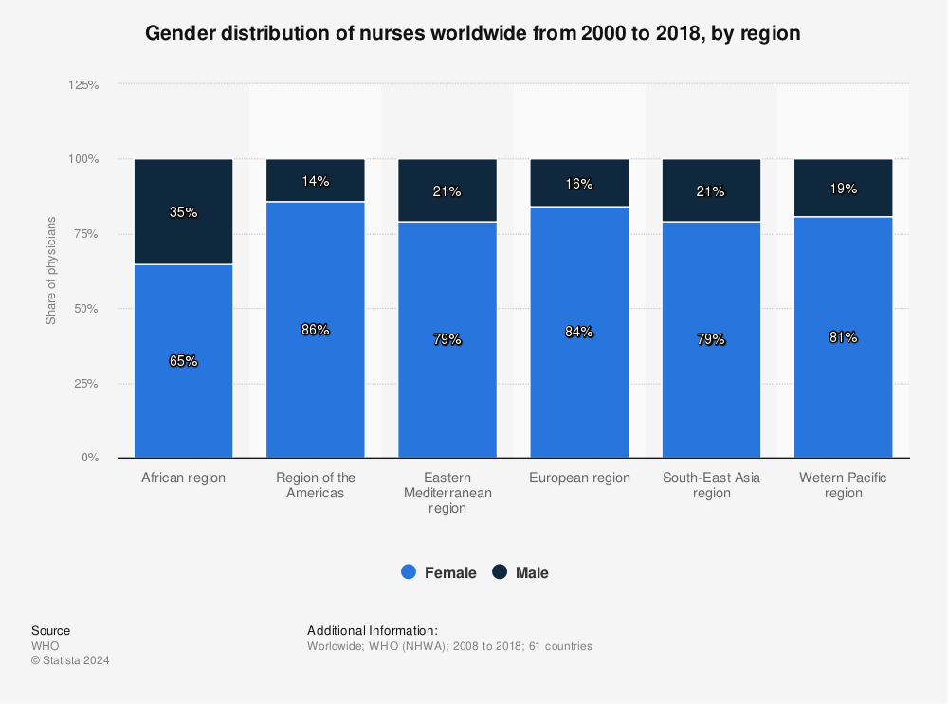
Research
Biases (Gender/Race/Age/Prominence)
Measurements (Count/Correlation/Shannon Entropy/Simpson Index/Evenness/Centre Distances/Percentage Area)
Innately biased images (Doctor/Nurse/Both)
Doctors – Male/White/Younger than 55
Nurse – Female/White/Younger than 55
Computer Assisted Annotation (DeepFace/FairFace)
Biased Models -> Impact results.
Human Annotation -> Serves as baseline.
Figure 2: Statista Doctor/Nurse Gender Distribution
Figure 2 - https://www.statista.com/statistics/1099789/distribution-of-physicians-across-regions-worldwide-by-gender/ / https://www.statista.com/statistics/1099804/distribution-of-nurses-across-regions-worldwide-by-gender/

Slide 5
Implementation
Image Generation
Image Annotation
Metric Extraction
Conclusion

Slide 6
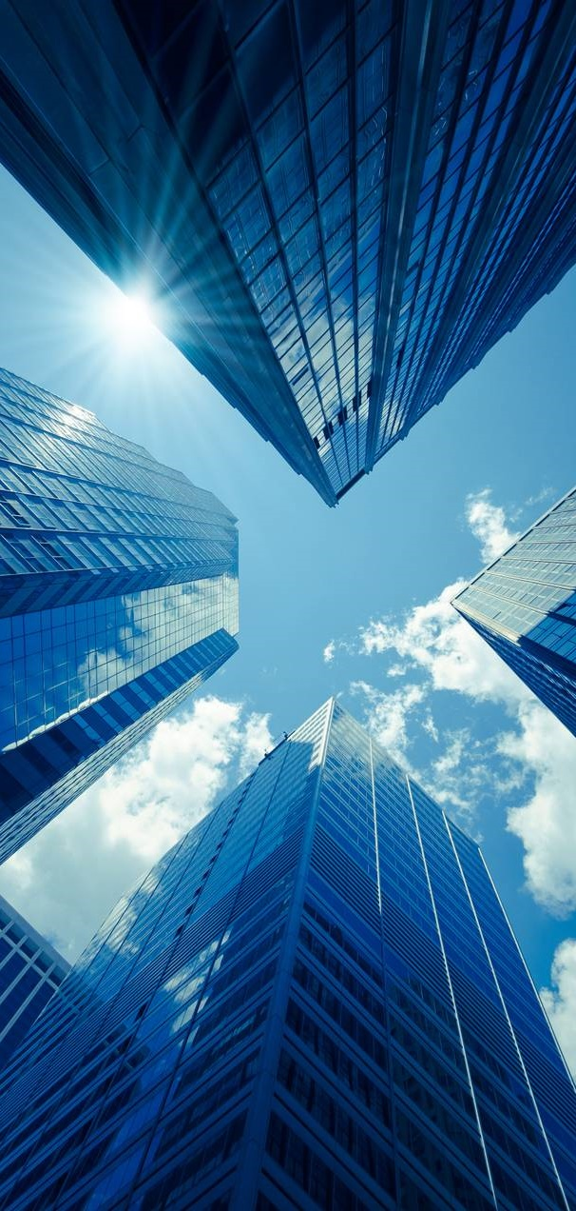
Image Generation
Prompt - ”A picture of a [subject] facing forward”
Negative Prompt - ”Disfigured” and ”Art”
Prompt Alteration (Dall-E)
No. of Images
Image Retrieval
Tagged (Doctor/Nurse)
Manual Filtering
Random Selection
No. of Images

Slide 7


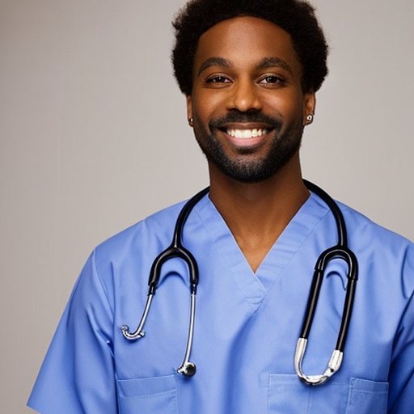
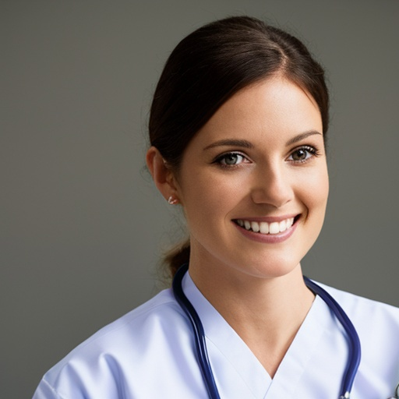





Stable Diffusion Images

Slide 8
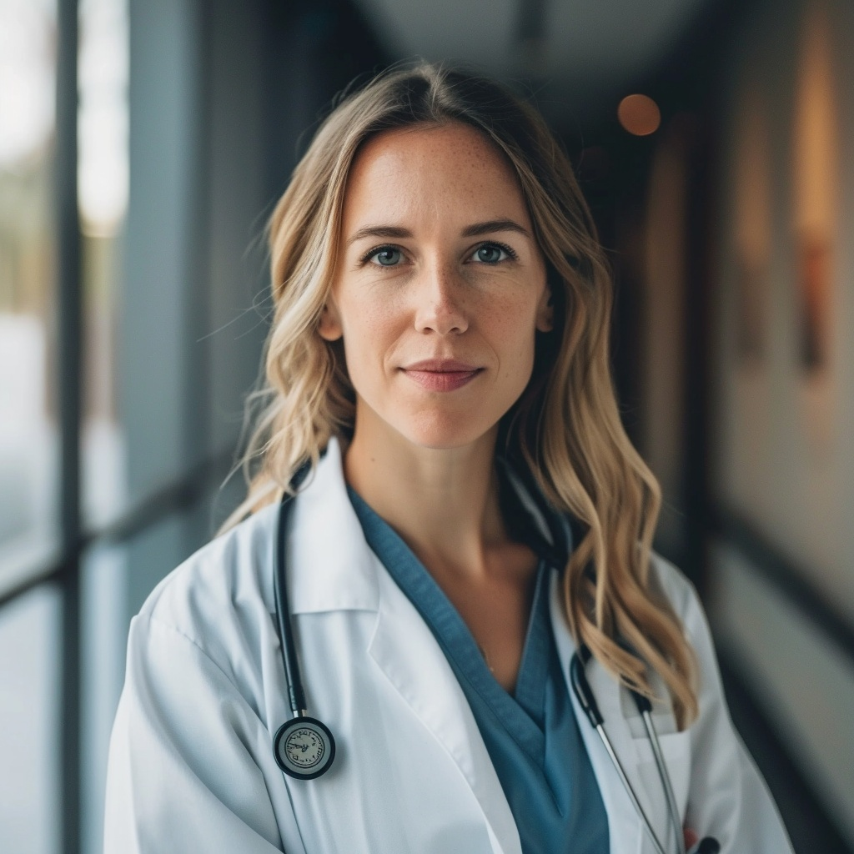
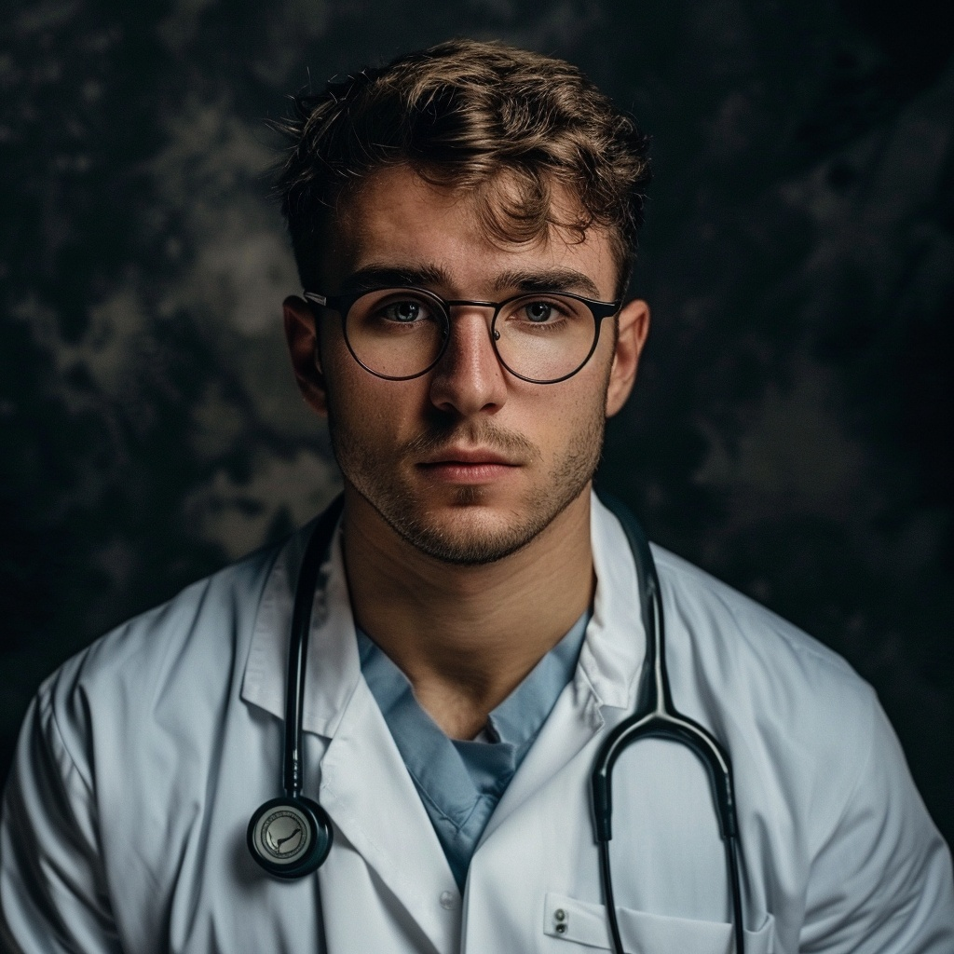
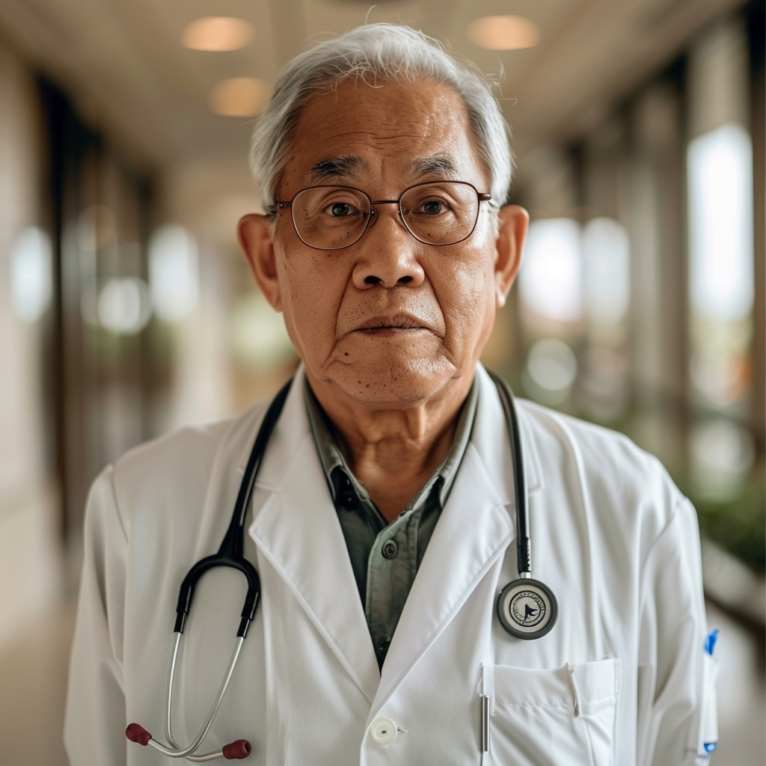
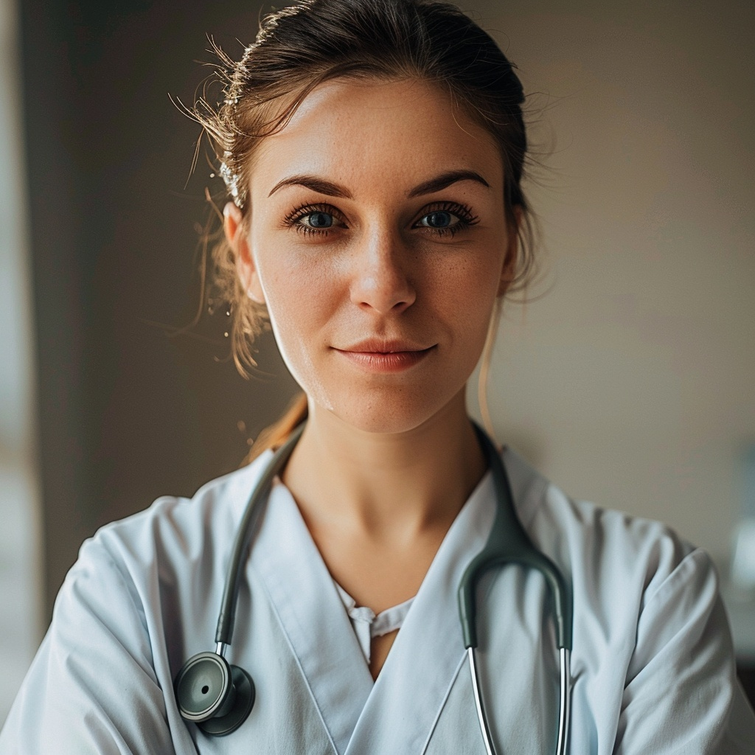
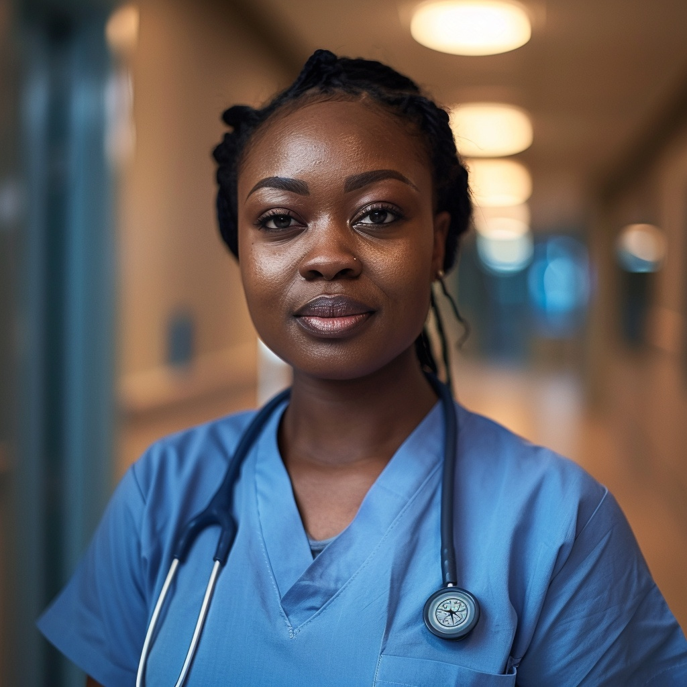
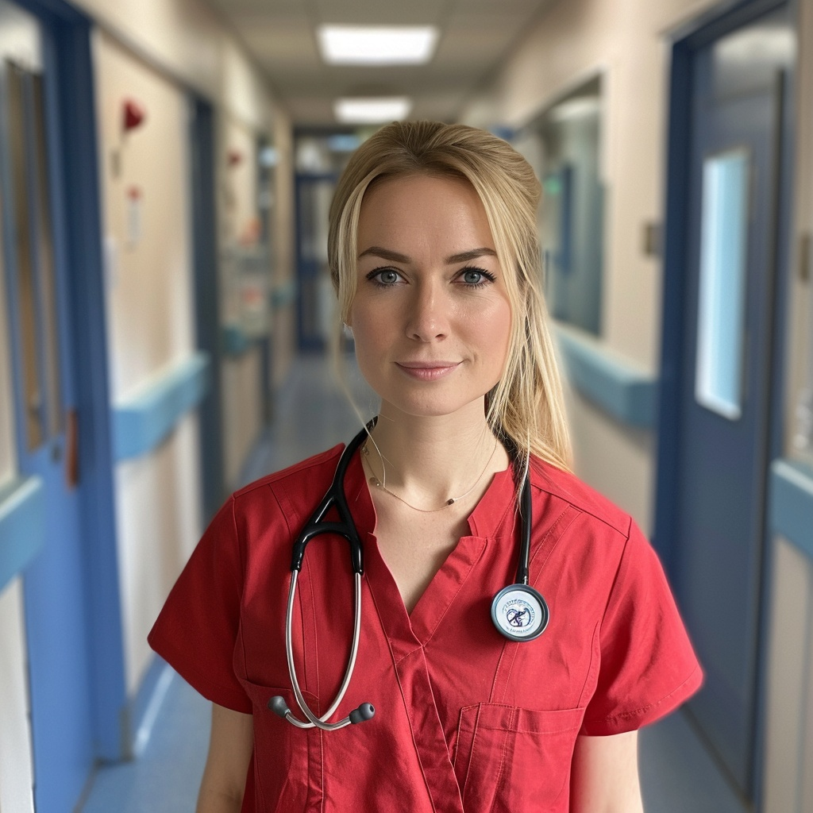
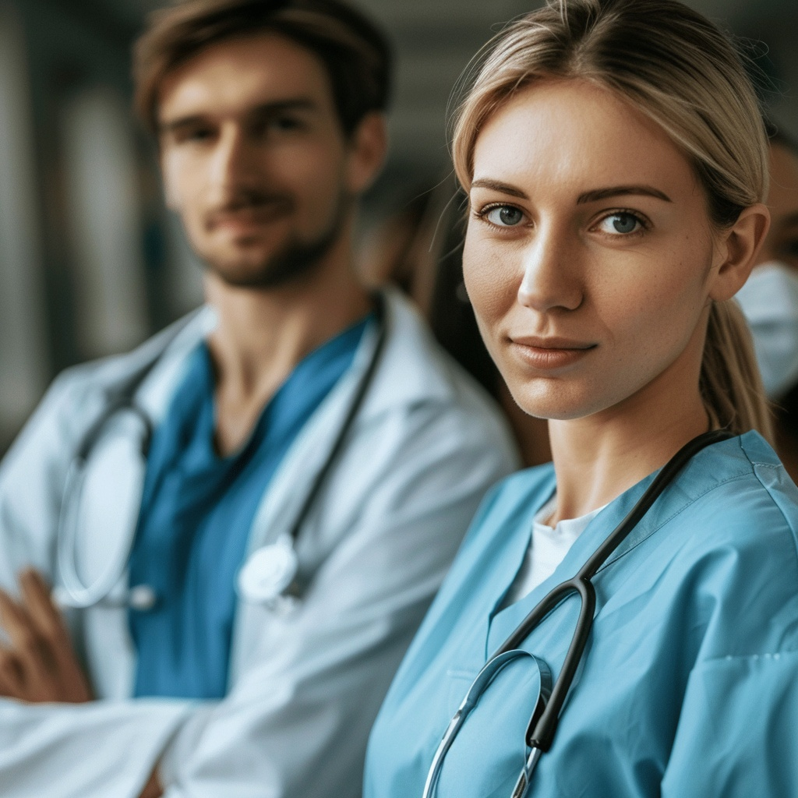

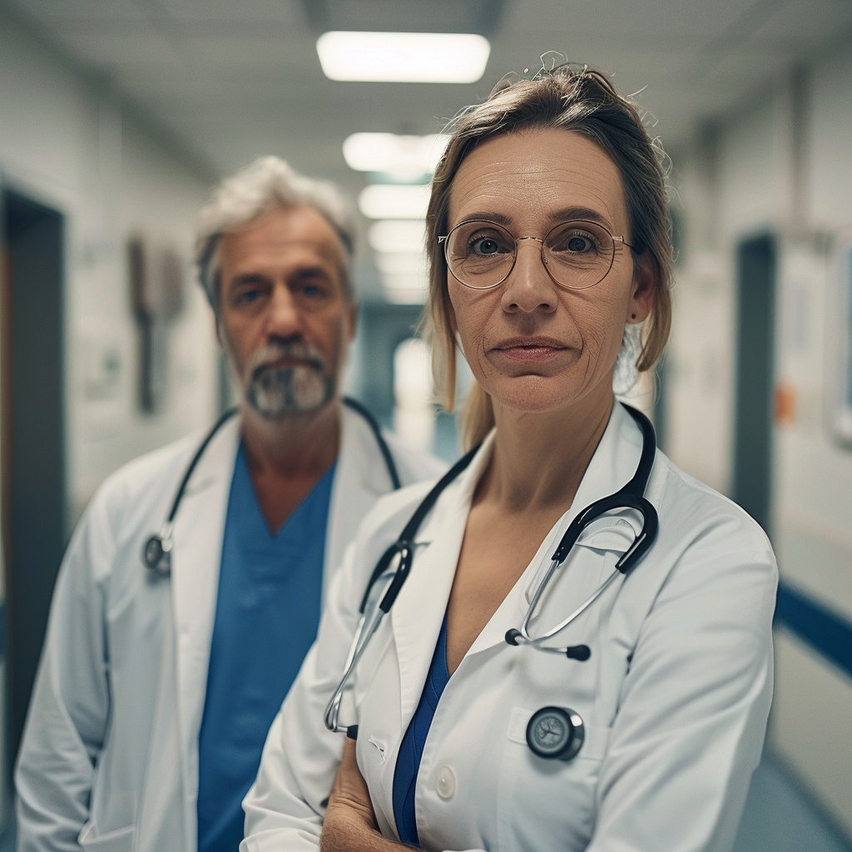
Midjourney Images

Slide 9

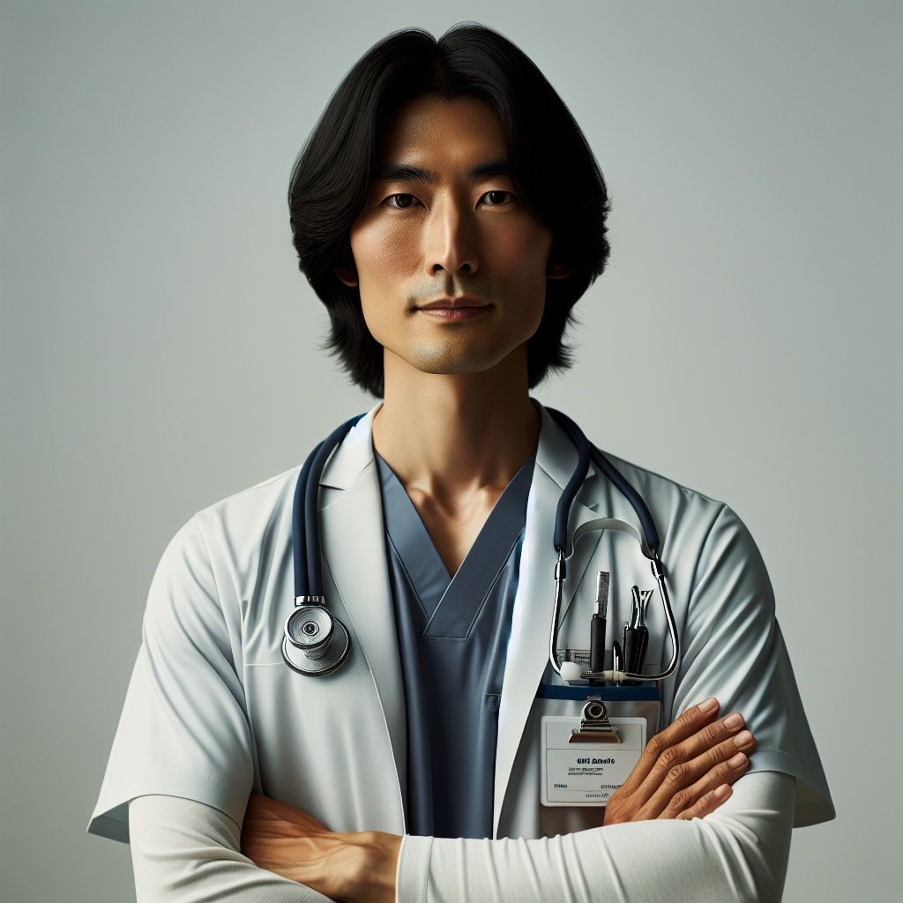
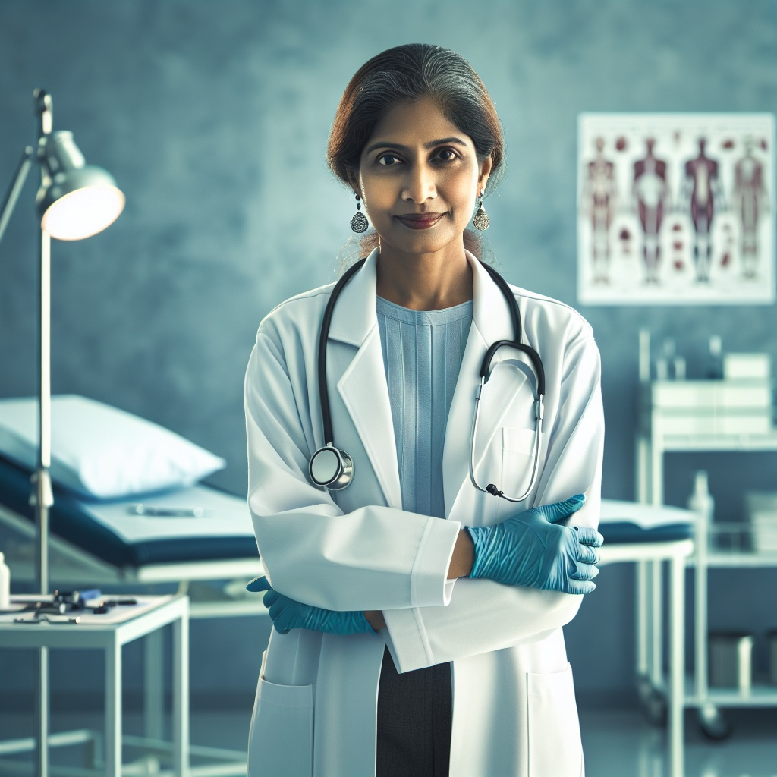
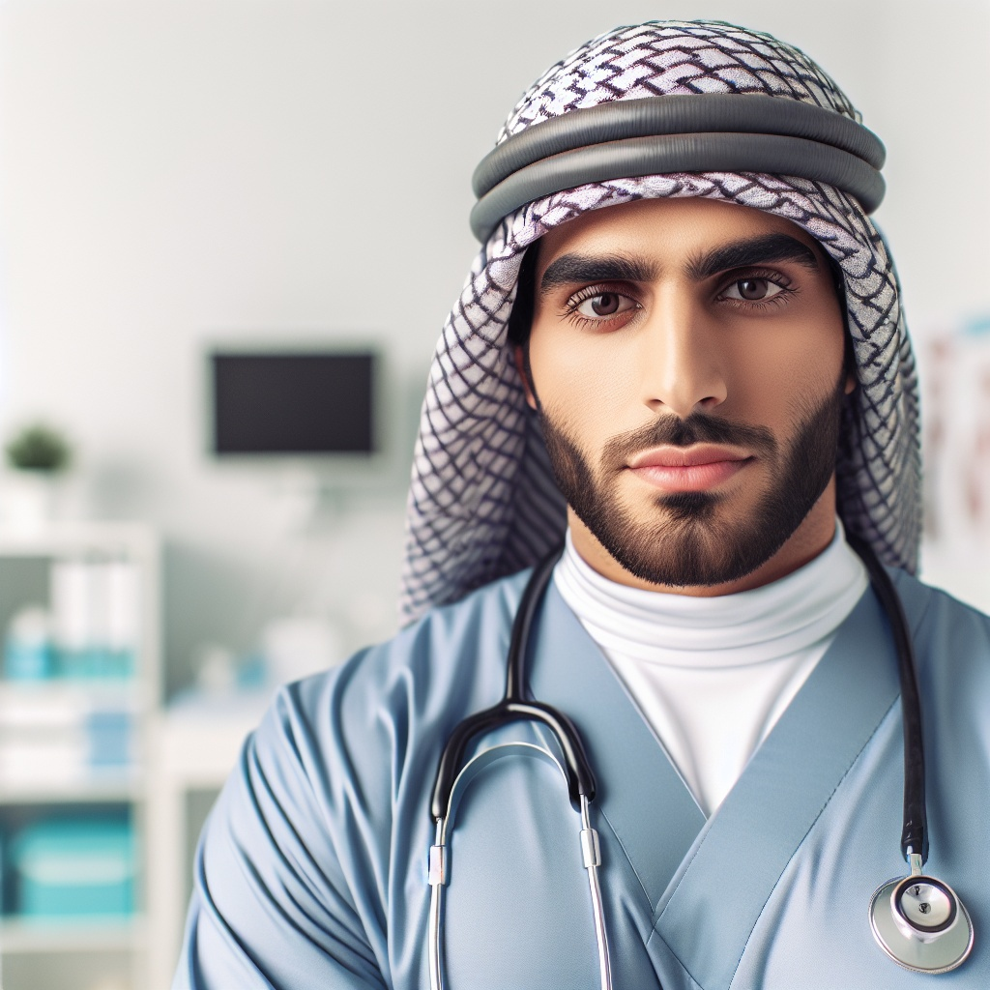
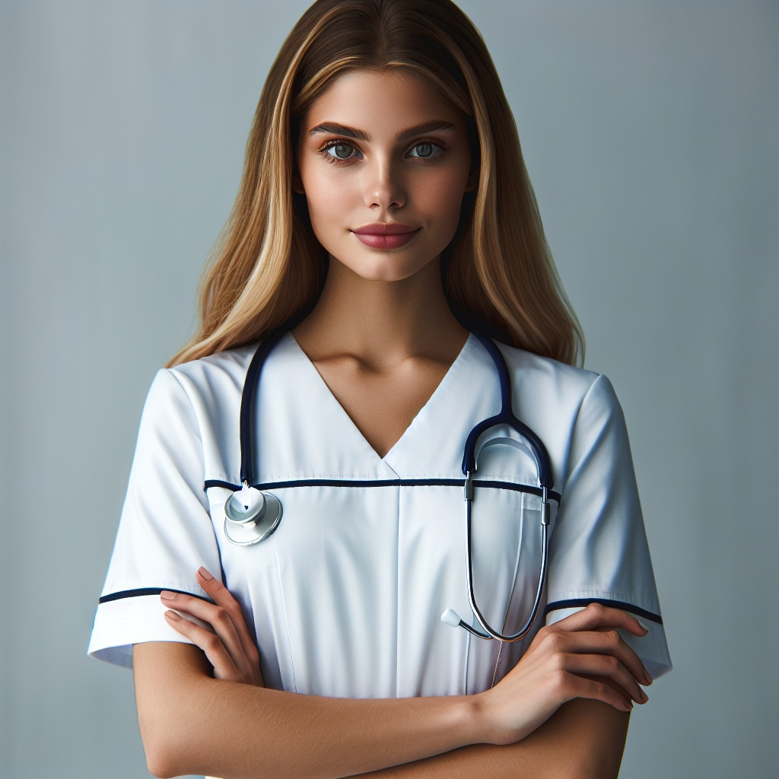
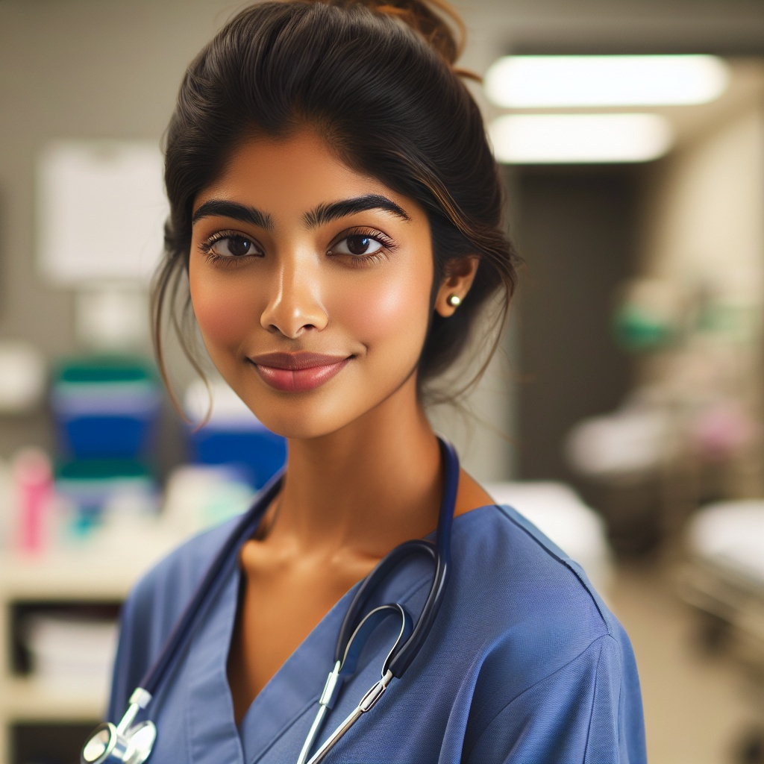


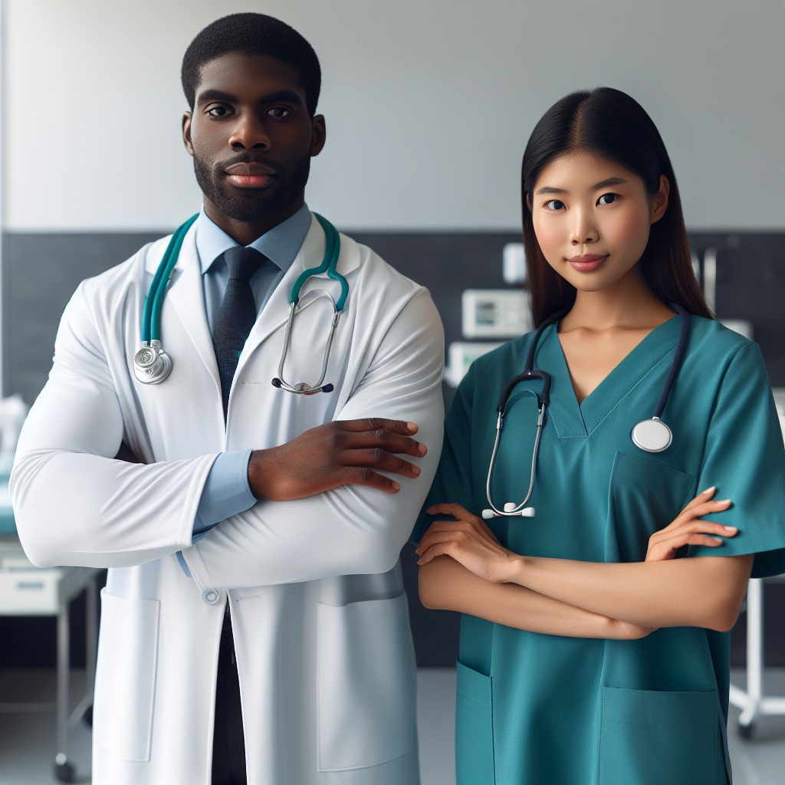
Dall-e Images

Slide 10
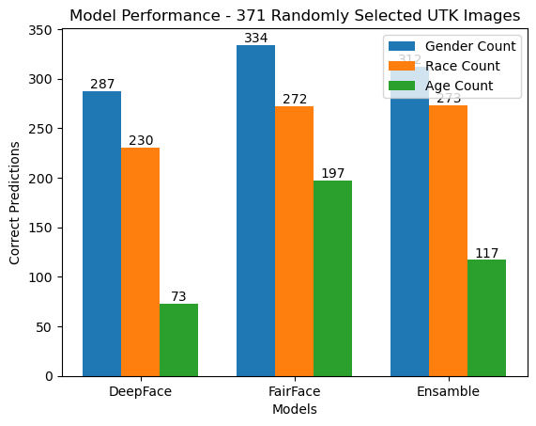
Annotation
UTK-Face Dataset
Ensemble model abandoned
Main model (FairFace) – Human Annotation predictable bias
Labels
Gender – Male/Female
Race – Asian/White/Middle Eastern/Indian/Black/Latino Hispanic
Age – 0-2/3-9/10-19/20-20…60-69/70+

Slide 11
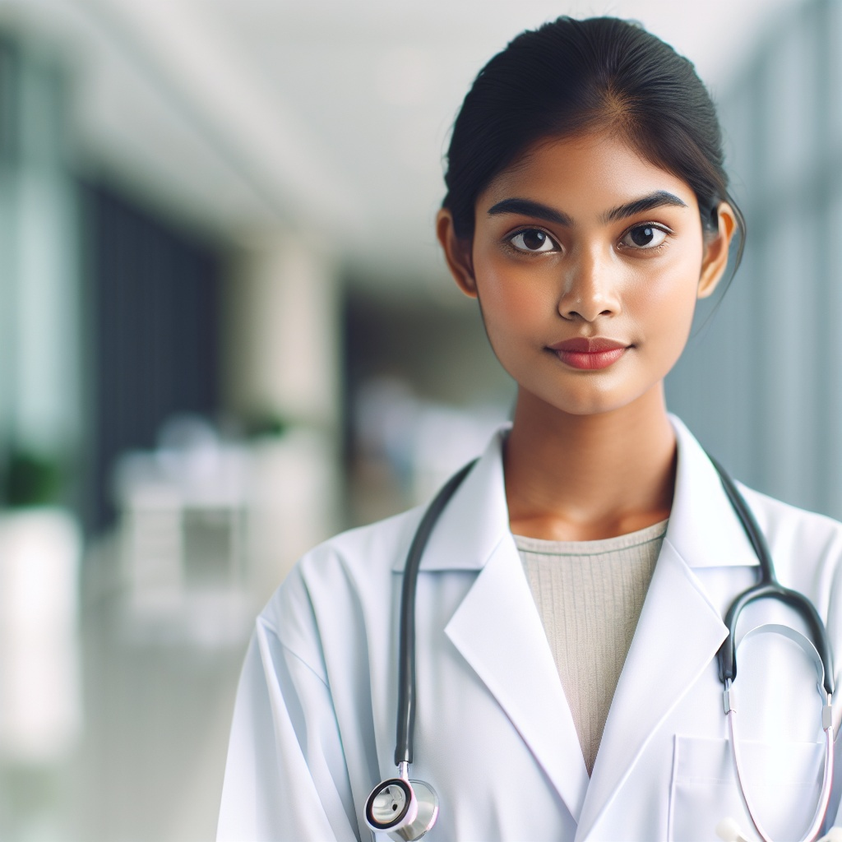
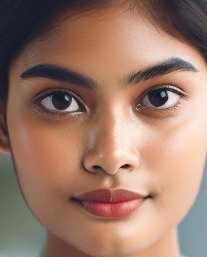
Metric Extraction
Image
{‘age’: label, ‘gender’: label, ‘race’: label, ‘centre_dist’: label, ‘space’: label}
Labels
{‘age’: confidence_dict, ‘gender’: confidence_dict, ‘race’: confidence_dict}
Confidence

Slide 12
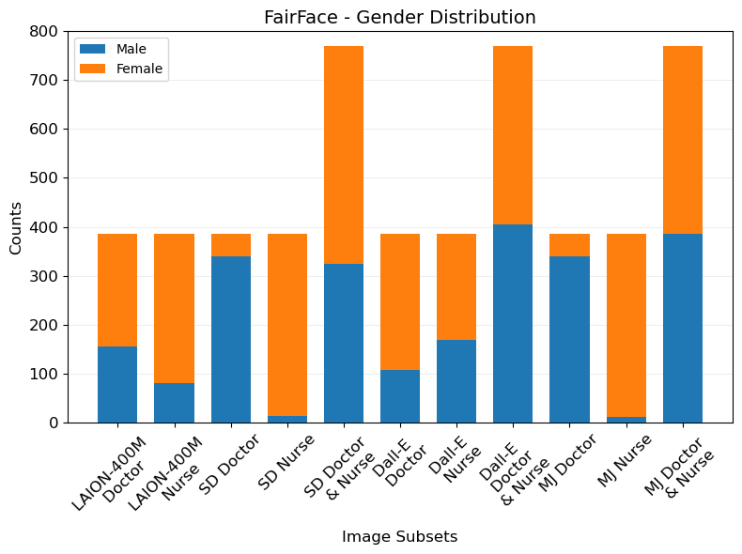
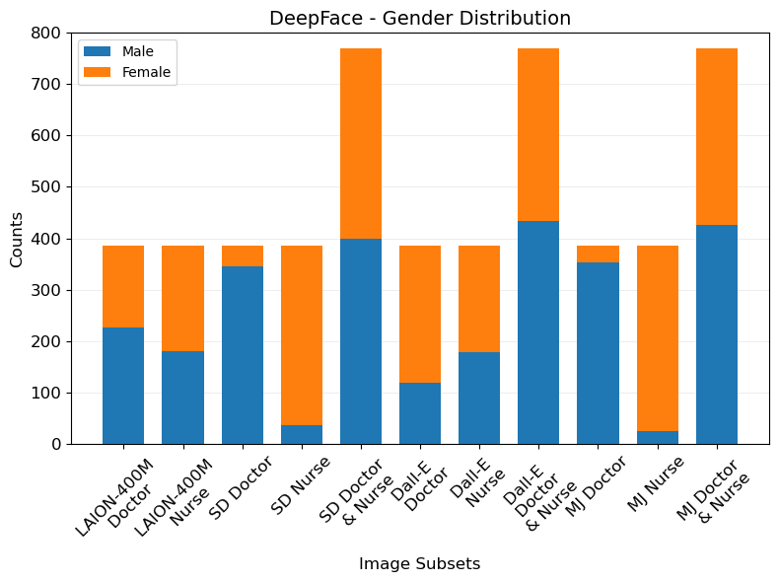
Conclusion - Gender
Real-World
Doctor - >50% Male (Globally)
Nurse - 76.91% Female (Globally)
LAION-400M
Doctor - 40.26% / 58.96% Male
Nurse – 79.22% / 53.25% Female
Stable Diffusion
Doctor - 88.31% / 89.61% Male
Nurse - 96.62% / 90.65% Female
Dall-E
Doctor - 27.79% / 30.91% Male
Nurse – 56.1% / 53.51% Female
Midjourney
Doctor - 88.31% / 91.69% Male
Nurse - 97.14% / 93.77% Female

Slide 13
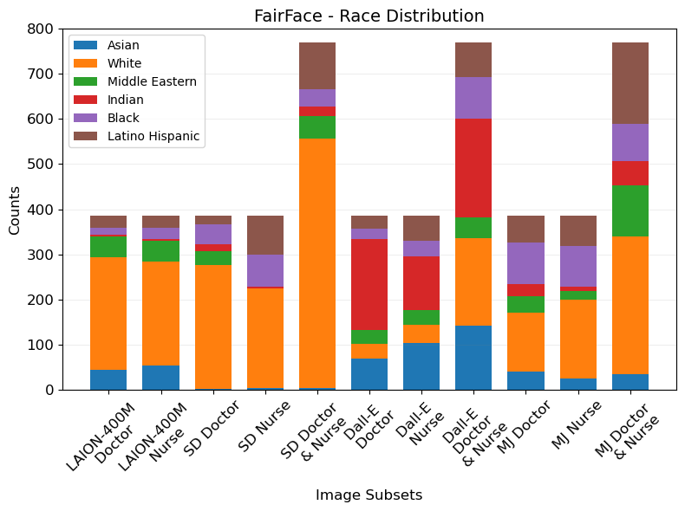
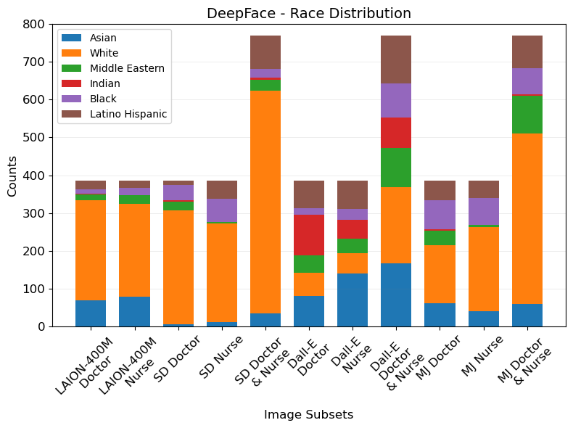
Conclusion - Race
Real World
Doctor - 56.2% White (America)
Nurse - 80% White (America)
LAION-400M
Doctor - 64.94% / 69.09% White
Nurse - 59.74% / 64.16% White
Stable Diffusion
Doctor - 71.17% / 78.18% White
Nurse – 57.4% / 68.05% White
Dall-E
Doctor - 8.57% / 15.84% White (Fair distribution)
Nurse - 10.65% / 14.29% White (Fair distribution)
Midjourney
Doctor - 34% / 40% White
Nurse – 45% / 57% White

Slide 14
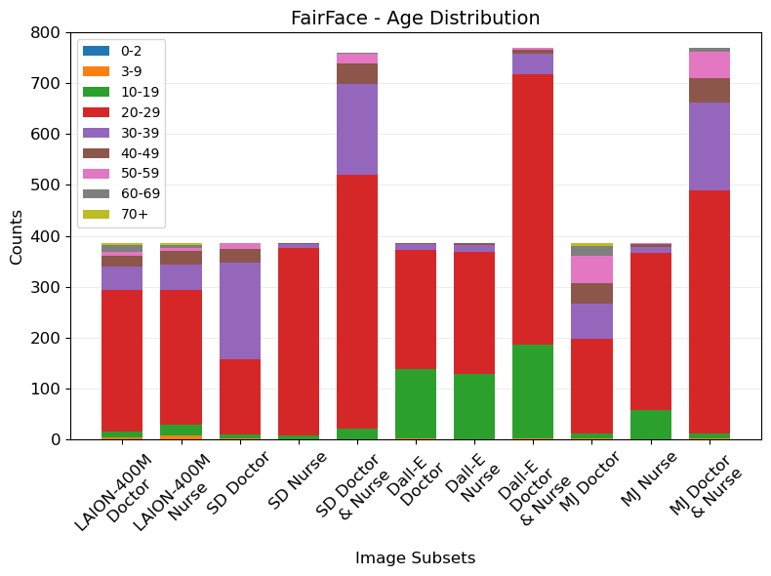
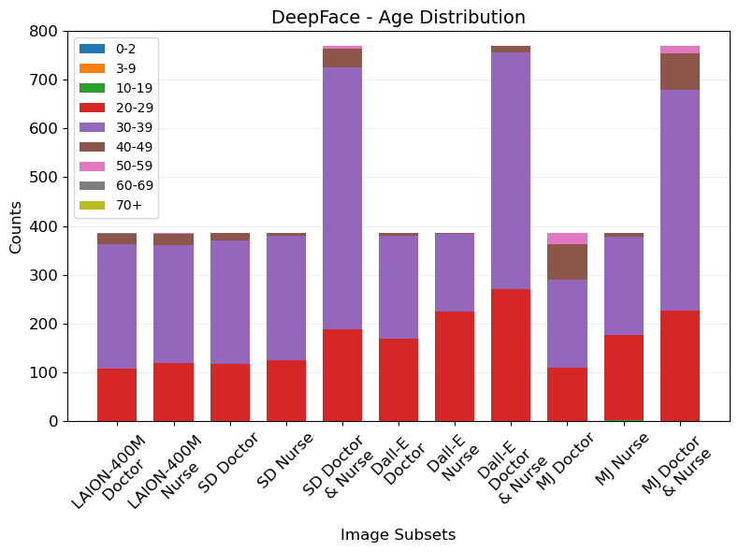
Conclusion - Age
Real World
Doctor - 66% younger than 55 (Globally)
Nurse - 81.62% younger than 55 (Globally)
LAION-400M
Doctor - 93.77% / 99.74% younger than 55
Nurse - 96.36% / 99.74% younger than 55
Stable Diffusion
Doctor - 96.88% / 100% younger than 55
Nurse - 100% / 100% younger than 55
Dall-E
Doctor - 100% /100% younger than 55
Nurse – 100% / 100% younger than 55
Midjourney
Doctor - 79.22% / 94.03% younger than 55
Nurse – 99.74% / 100% younger than 55

Slide 15
Conclusion - Prominence
Should I add a conclusion slide for prominence seeing as nothing insightful was derived from the measurements?

Slide 16
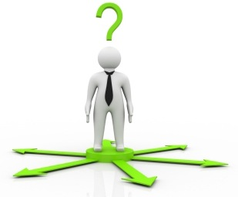
Future Work
Generative model designed to mitigate biases
Investigation of Dall-E prompt altering model and its effectiveness
Creating unbiased training datasets

Slide 17
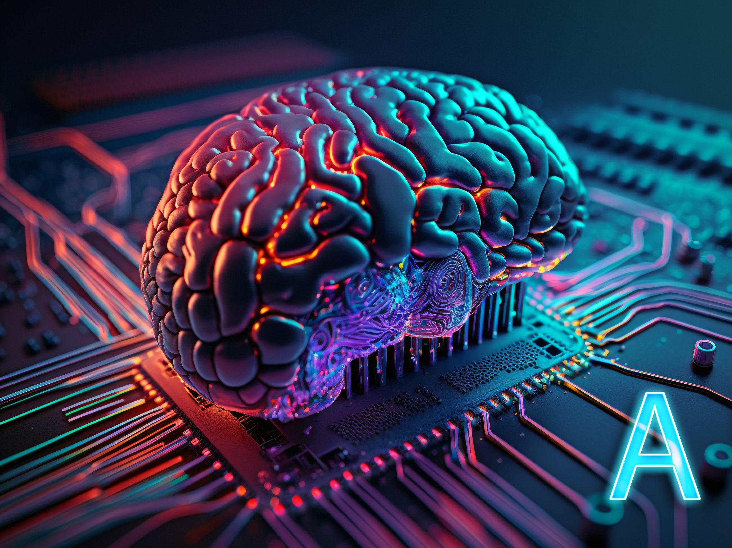
THANK YOU for your time! Any Questions?

